Slide 1

Unit 3 Aggregate demand and the multiplier model
How economies fluctuate between booms and recessions as they are continuously hit by good and bad shocks
PART 3

Slide 2
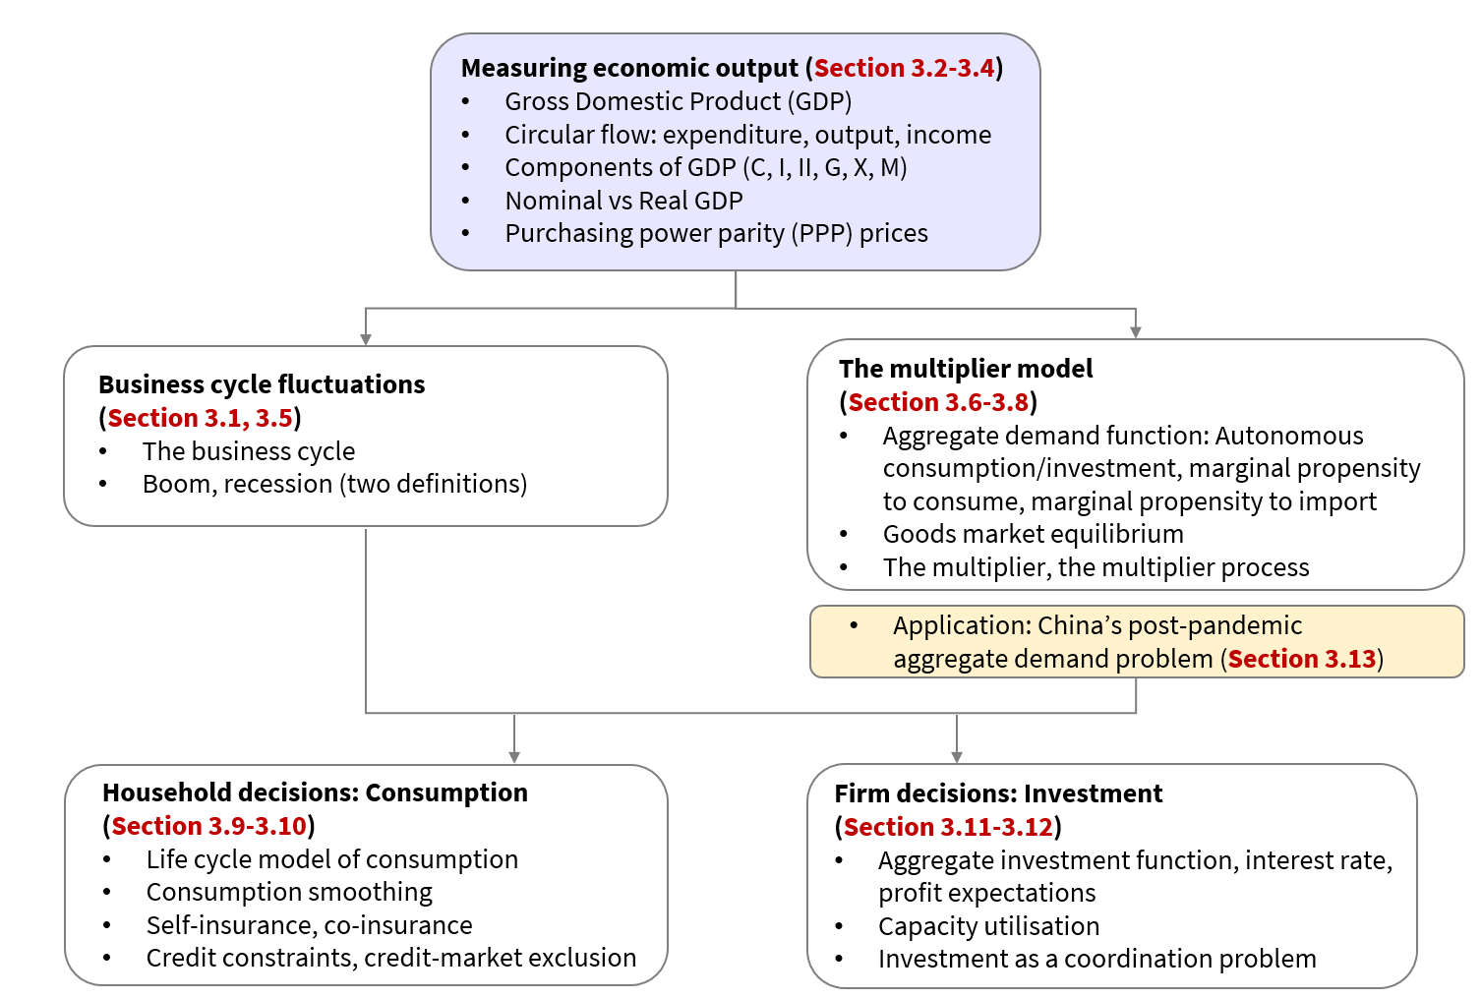
Topic ❶
3.9 Why is consumption relatively smooth?
Topic ❷
Topic ❸
Topic ❹

Slide 3
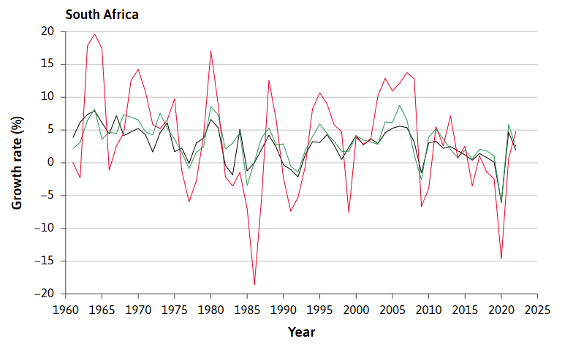
Figure 3.10b Growth rates of consumption, investment, and GDP in South Africa, per cent per annum (1961–2022)

Slide 4
Consumption smoothing
Spreading out consumption relatively evenly between time periods is called consumption smoothing.
One powerful motivation for wanting to save or borrow is to be able to purchase the necessities of food, rent, phone contract, and electricity in every period. Another reason for consumption smoothing is that the additional benefit we gain from increased consumption falls as our consumption level rises.
For these reasons, people generally prefer to consume the same in each period rather than having a lot sometimes and a little at other times.
The desire of households to maintain a constant level of consumption provides a basic source of stabilization in any economy. Keeping consumption steady means households must plan. They think about what might happen to their income in the future, and they save and borrow to smooth the bumps in income.

Slide 5
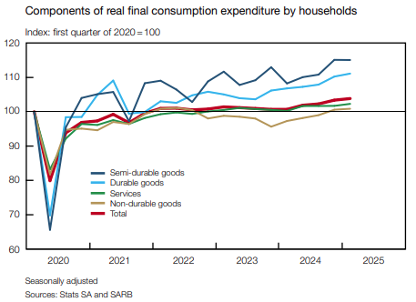


Slide 6
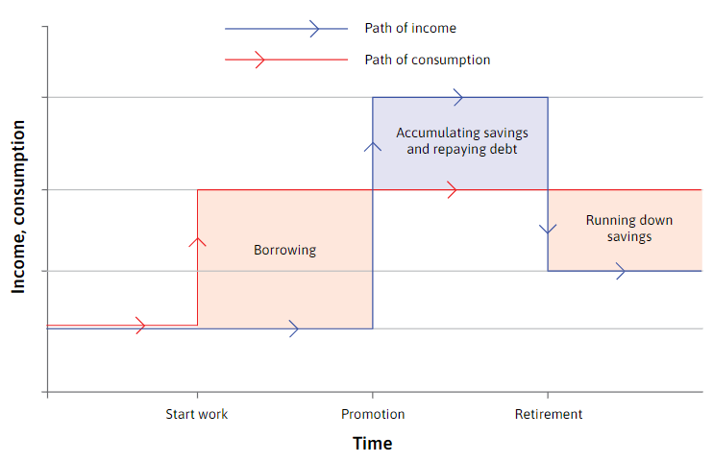
Smoothing consumption
Households make lifetime consumption plans based on expectations about the future, and react to shocks (which influences income)
life cycle model of consumption
Figure 13.10 Consumption smoothing through our lifetime
Notes:
At this time income is low. The individual saves and repays the debt when older and earning more, and finally runs down savings after retirement, when income falls again.

Slide 7
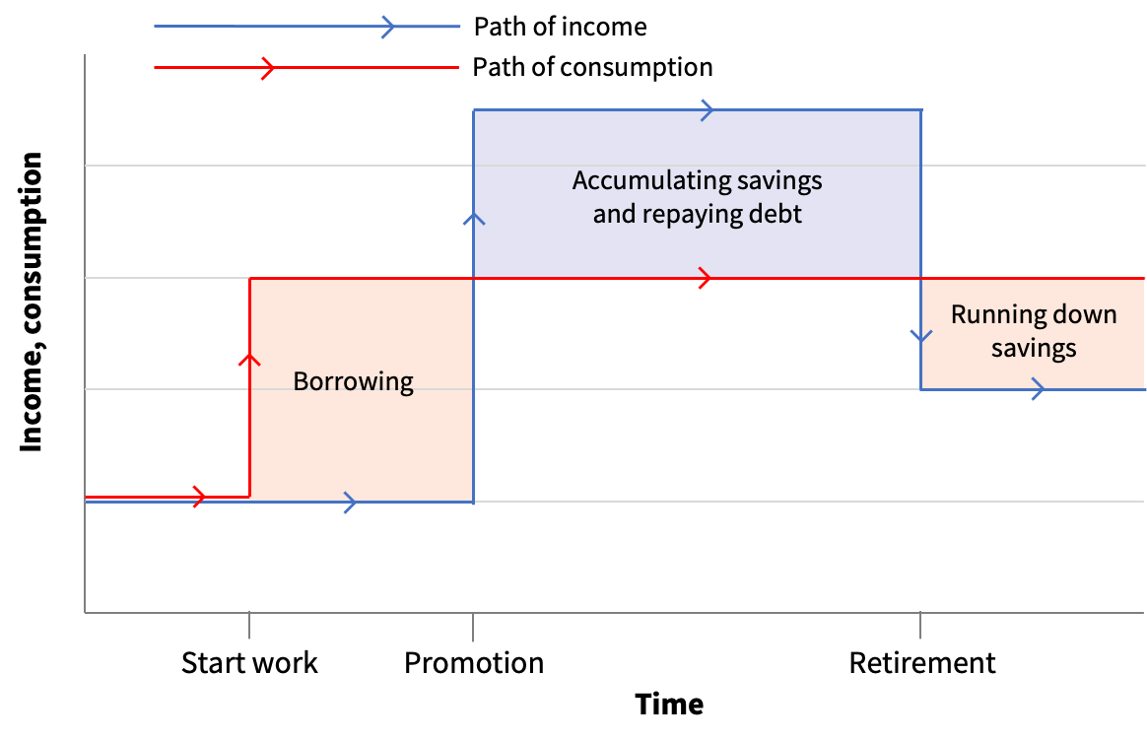
Consumption changes before income does, and that this is only possible if the individual can borrow. While earnings are low, a smooth path of consumption means the individual wants to consume more than their income. A key assumption in the model is that they can do so by borrowing. But when earnings are high, consumption is below income, as some of the income is used to repay debt and save for retirement.
life cycle model of consumption

Slide 8
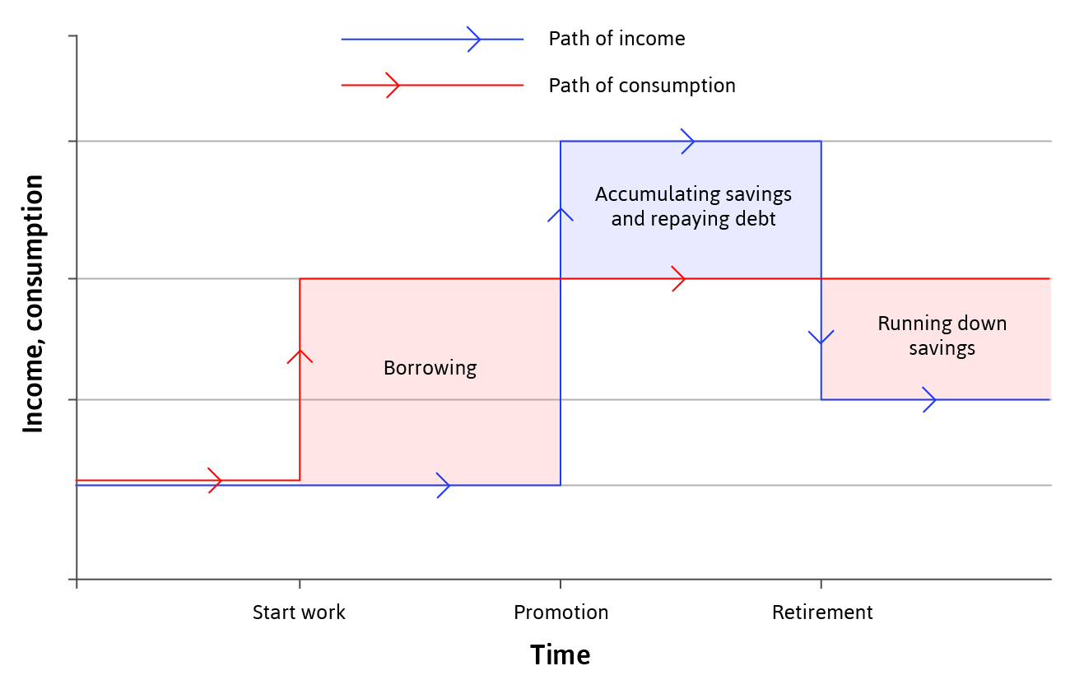
Smoothing consumption
Households make lifetime consumption plans based on expectations about the future, and react to shocks (which influences income)
Readjust long-run consumption (red line) if shocks are permanent
Do not change long-run consumption if shocks are temporary
Figure 13.10 Consumption smoothing through our lifetime.

Slide 9
Do Question 3.11

Slide 10
Topic ❶
3.10 Shocks to households and the limits to smoothing consumption
Topic ❷
Topic ❸
Topic ❹

Slide 11
Shocks
Shock = an unexpected event (such as extreme weather) which causes GDP to fluctuate.
There are two broad types of shocks:
Good or bad fortune strikes the household
Good or bad fortune strikes the entire economy

Slide 12
Dealing with shocks
People use two strategies to deal with idiosyncratic shocks—shocks that are specific to their household:
Self-insurance: Households that encounter an unusually high income in some period will save, so that when their luck reverses, they can spend their savings. They may also borrow in bad times if they can. It is called self-insurance because other households are not involved.
Co-insurance: Households that have been fortunate during a particular period can help a household hit by bad luck. Sometimes this is done among members of extended families or among friends and neighbours. Since the mid-twentieth century, particularly in richer countries, co-insurance has taken the form of citizens paying taxes, which are then used to support individuals who are temporarily out of work or when there is an economy-wide shock (unemployment benefits, furlough payments in the pandemic).

Slide 13
Economy-wide shocks (e.g. Covid-19 pandemic)
Co-insurance is less effective if the bad shock hits everyone at the same time.
But when these shocks hit, co-insurance is even more necessary.
In farming economies of the past that were based in volatile climates, people practised co-insurance based on trust, reciprocity, and altruism.

Slide 14
Consumer preferences
Self-insurance and co-insurance reflect two important aspects of the preferences⁠ of many households:
Households prefer a smooth pattern of consumption
But they may have a bias towards the present
Households are not solely selfish

Slide 15
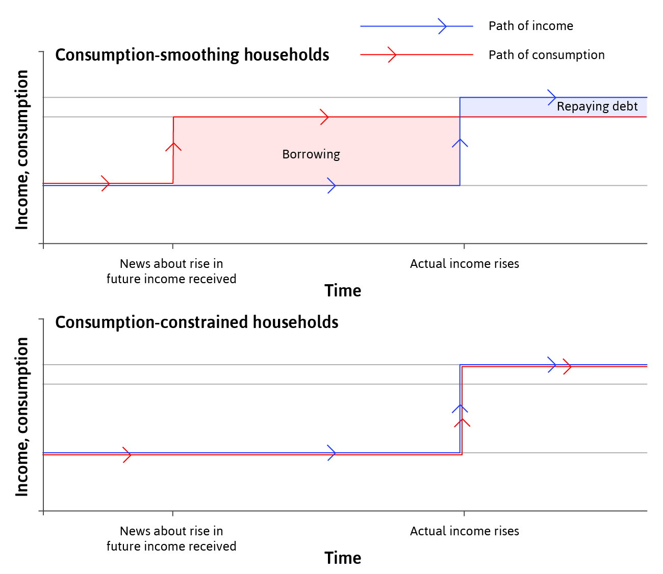
Limitations to smoothing: credit constraints
Credit constraints – limits on amount borrowed/ability to borrow.
The households unable to adjust to a temporary income shock, have lower welfare.
Figure 3.18 Consumption
when credit constraints bind.

Slide 16
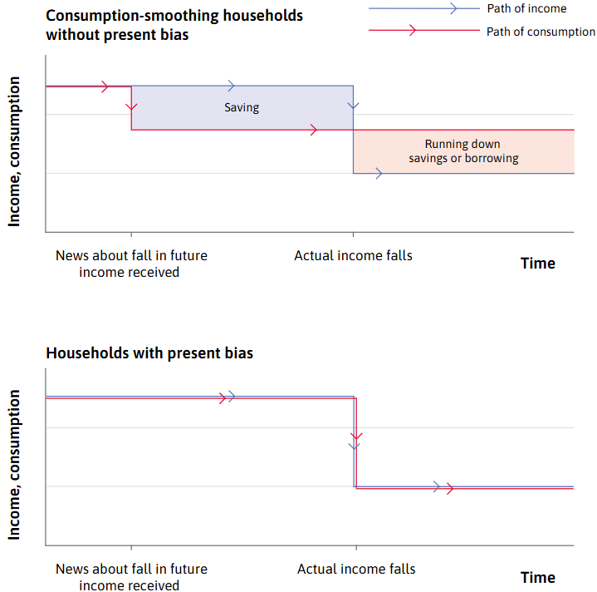
Limitations to smoothing: Present bias
Present bias – a household that demonstrates present bias will be reluctant to reduce their current consumption, keeping it at the initial level until income falls. consumption falls further than it does for the consumption-smoothing household
Figure 3.19 Consumption when households demonstrate present bias: an anticipated fall in income

Slide 17
Limitations to smoothing: credit constraints
Many countries in Africa has particularly shallow financial markets.
This makes obtaining credit for consumption smoothing particularly difficult.
In the past, this has meant that African households were exposed to deepening poverty during times of negative exogenous shocks.
However; Mobile banking has become one method of reducing credit constraints in Africa (mpesa, etc)
In SA: Sophisticated financial markets, but mostly excludes the poor and low-income earners from credit due to lack of collateral and education on accessing these financial credit markets. Those excluded then resort to informal short-term credit markets with exorbitant interest rates.

Slide 18
Consumer behaviour and the multiplier model
We can think of the multiplier model as applying to an economy that consists of two types of households. Some households smooth their consumption by borrowing and saving: we can think of these as having an MPC of zero (c₁ = 0). But others, due to some combination of credit constraints and present bias, have an MPC of 1 (c₁ = 1).
If we average across the two types of households to find the aggregate consumption function, this gives an average MPC between 0 and 1 as in the multiplier model. Whether the aggregate MPC is high or low thus depends on the proportion of households in each group.
Shifts in the proportion who are credit constrained and therefore have a high MPC affect the size of the multiplier. This helps explain why the multiplier is found to be higher in deep recessions than it is in booms.

Slide 19
Do Question 3.13

Slide 20
Topic ❶
Topic ❷
Topic ❸
3.11 Why is investment volatile?
Topic ❹
Topic ❺

Slide 21
Figure 3.10b Growth rates of consumption, investment, and GDP in South Africa, per cent per annum (1961–2022)

Slide 22
Why is investment volatile?
Households tend to smooth their consumption spending when they can, but there is no similar motivation for a firm to smooth investment spending.
Firms increase their stock of machinery and equipment and build new premises whenever they identify an opportunity to make profits. But, unlike eating and most other consumption expenditures, investment can be postponed.
There are several reasons why this is likely to produce clusters of investment projects at some times and few at other times:
New technology
Credit constraints

Slide 23
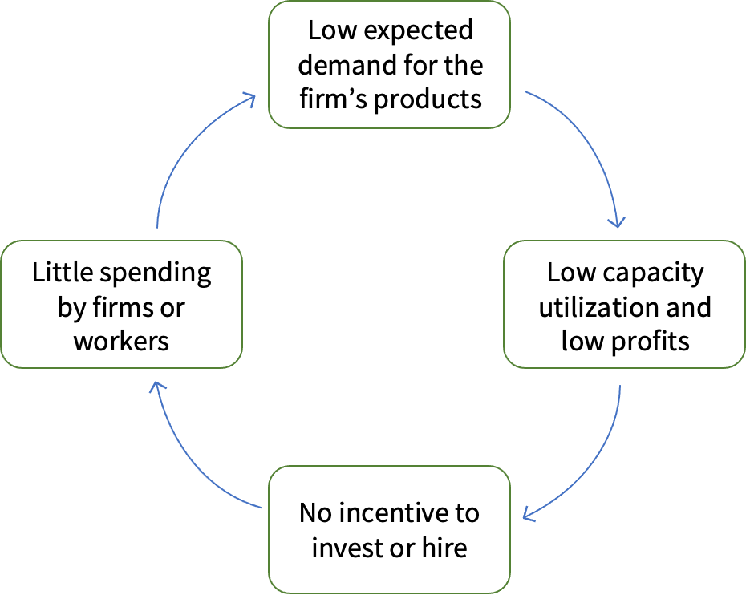
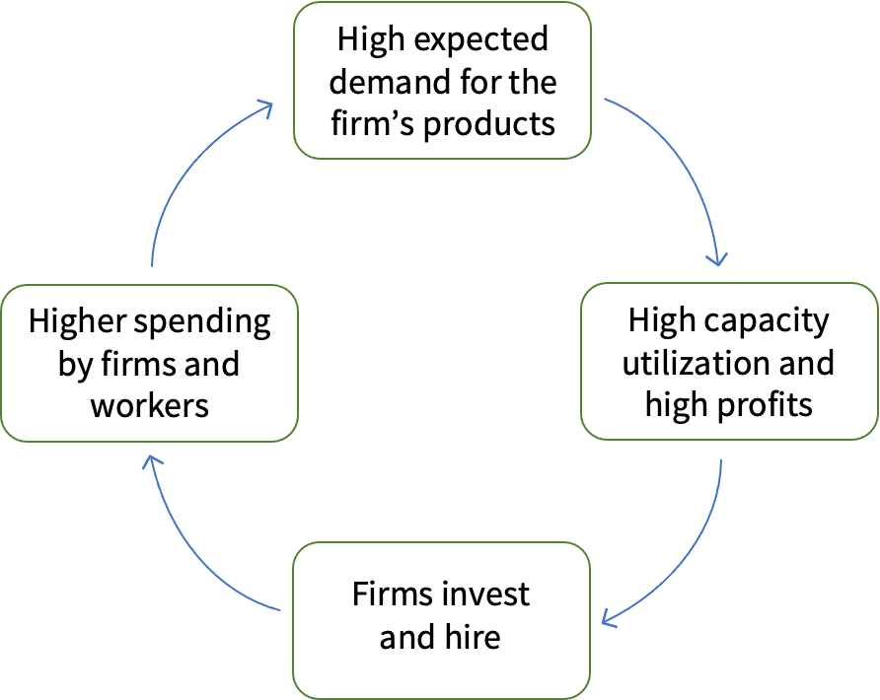
A coordination problem

Slide 24
Volatile Investment
Firms don’t have preferences for smoothing like households.
They adjust investment plans to both temporary and permanent shocks, to maximise their profits.
High demand → high capacity utilization*
→ investment → even higher demand
Investment decisions depend on firms’ expectations about future demand
*Capacity utilisation rate is the measure of the extent to which a firm, industry or a whole economy produces as much as the stock of its capital goods and current knowledge allows.

Slide 25
Do Question 3.13

Slide 26
Topic ❶
Topic ❷
Topic ❸
3.12 Investment spending in the multiplier model
Topic ❹
Topic ❺

Slide 27
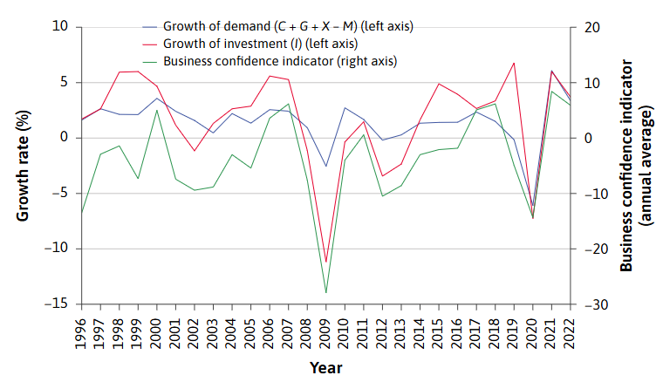
Business confidence
Figure 3.23 Investment and business confidence in the Eurozone (1996-2022)
Business confidence coordinates firms to invest at the same time.

Slide 28
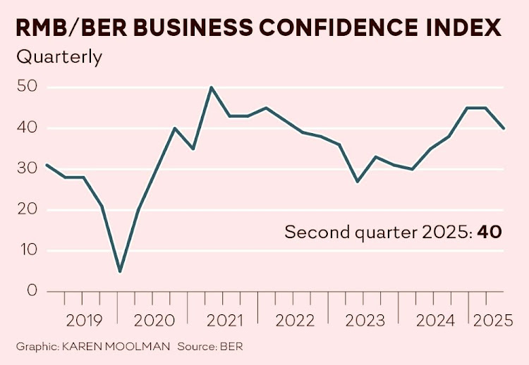
Business confidence

Slide 29
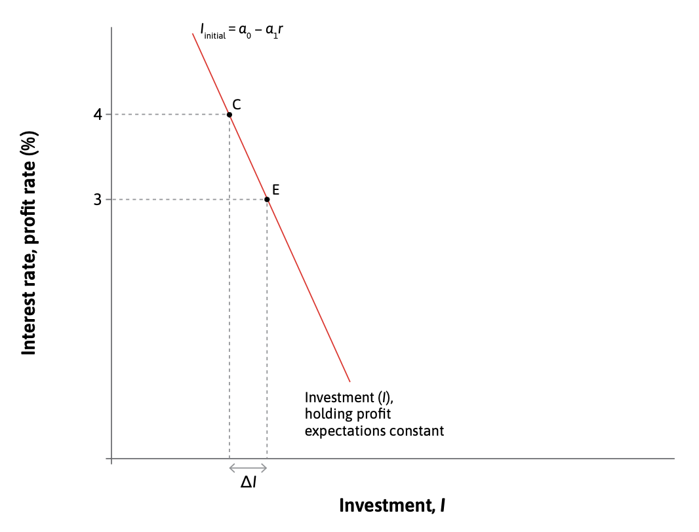
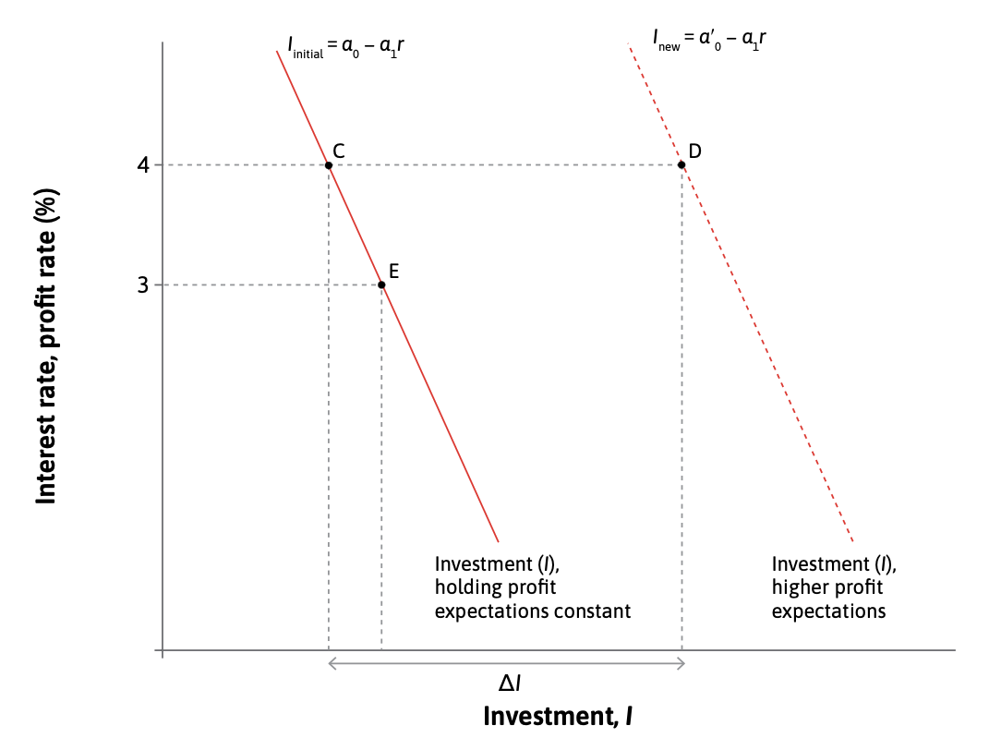
Aggregate investment function

Slide 30
Do Question 3.15

Slide 31
Other components of GDP
GDP = C + I + G + (X – M)
Government spending is less volatile than investment
(does not depend on business confidence)
Exports depend on demand from other countries, so will fluctuate according to the business cycles of major export markets.
Imports depend on demand on foreign goods depend on income

Slide 32
Section 3.13 Application: China’s post-COVID-19 aggregate demand problem is NOT PRESCRIBED

Slide 33
Summary
GDP is an imperfect but important measure of how much an economy produces.
Fluctuations in the GDP of a nation over the business cycle are caused by shifts in the aggregate demand for goods and services. They affect unemployment, and unemployment is a serious hardship for people.
Households respond to shocks by saving, borrowing, and sharing to smooth their consumption of goods and services. Due to limits on people’s ability to borrow (credit constraints) and their present bias, these strategies are not sufficient to eliminate fluctuations in their consumption.
Unlike consumption, spending on investment projects is often clustered.
The multiplier model is used to study the business cycle. It consists of the equation for goods market equilibrium and the equation for aggregate demand. Solving the two equations gives the formula for the multiplier, which in this model has a value greater than one.

Slide 34
Topic ❶
Topic ❷
Topic ❸
Topic ❹
Topic ❺

